Slide 1
CACC Development Vehicles

Slide 2
Proposed CACC Vehicle Fleet
Year/Make/Model | Powertrain | Acceleration Control | Deceleration Control
2018 Toyota Camry | CV | ACC Overwrite / Pedal Emulator* | ACC Overwrite
2018 Honda Accord | CV | ACC Overwrite/ Pedal Emulator* | ACC Overwrite
2017 Toyota Prius Prime | PHEV | ACC Overwrite/ Pedal Emulator*
2014 Honda Accord | PHEV | Pedal Emulator | Actuator
2014 BMW i3 | EREV | Pedal Emulator | Pedal Emulator and Actuator
* only if necessary to achieve maximum acceleration

Slide 3
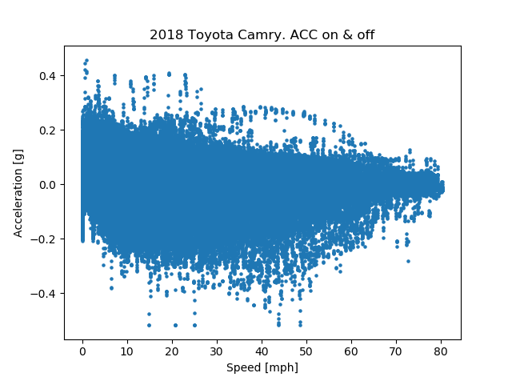
2018 Toyota Camry – Acceleration Capability
On-road data
Maximum braking not represented

Slide 4
2018 Honda Accord – Acceleration Capability
Data from dyno testing
Maximum braking not represented

Slide 5
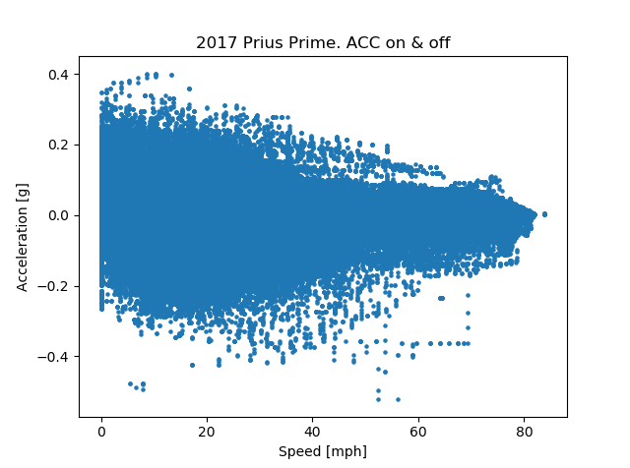
2017 Prius Prime – Acceleration Capability
On-road data
Maximum braking not represented

Slide 6
2014 Honda Accord – Acceleration Capability
Data from dyno testing
Maximum braking not represented

Slide 7
2014 BMW i3 – Acceleration Capability
Using accelerator pedal emulator only
Higher deceleration possible with brake pedal actuator

Slide 8
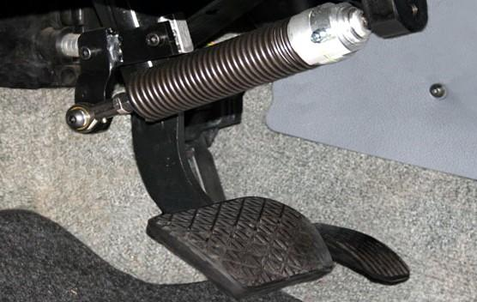
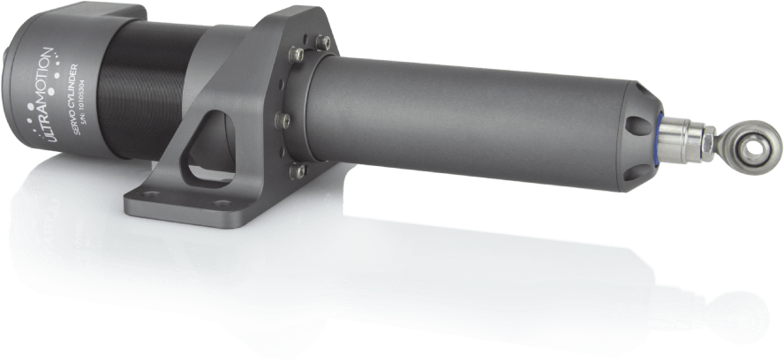
Actuator Control (Mechanical Actuation)
Possible Actuator:
https://www.ultramotion.com/servo-cylinder/
Price: $2000-$3000
3-4 week lead time
Transferrable from one vehicle to another
Requires mounting using custom bracket
Some intrusion in foot compartment

